Slide 1
Calculo Numérico I IF-321
Dr. Luis Sanchez

Slide 2
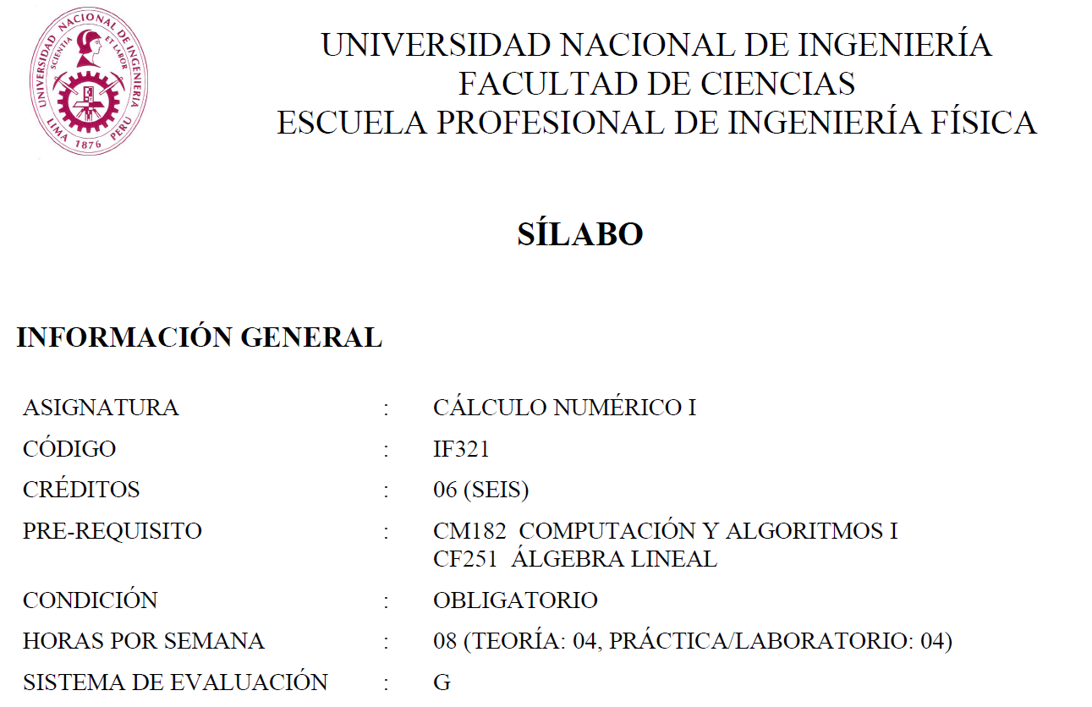

Slide 3
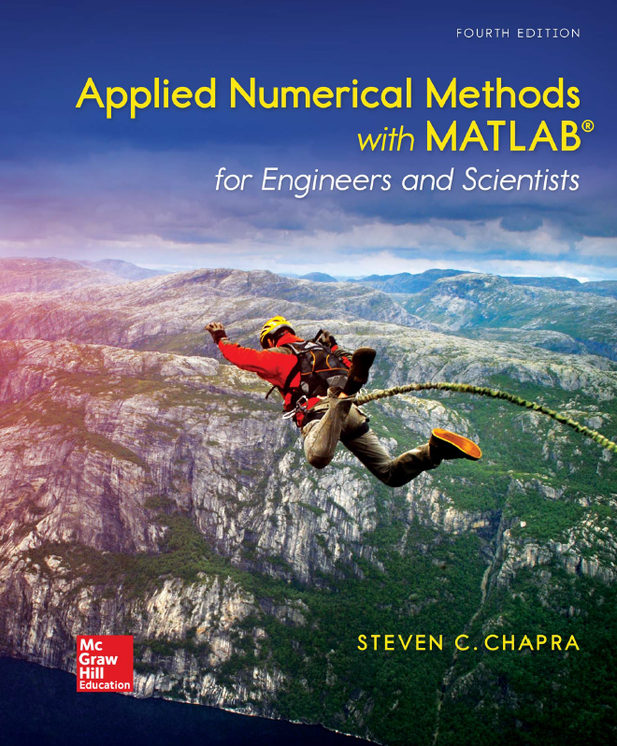
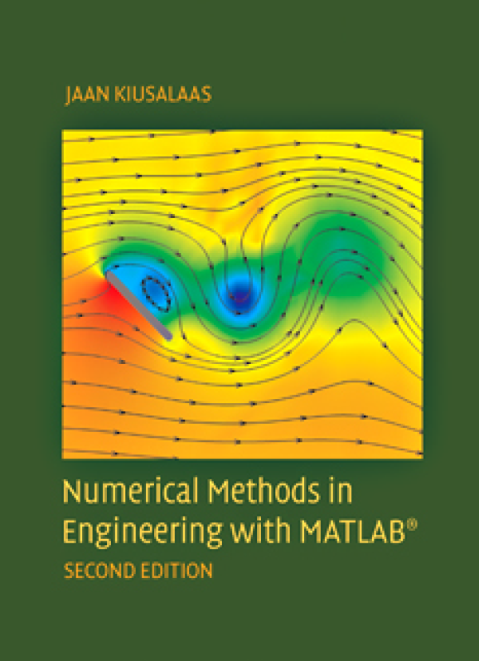
Bibliografía:

Slide 4
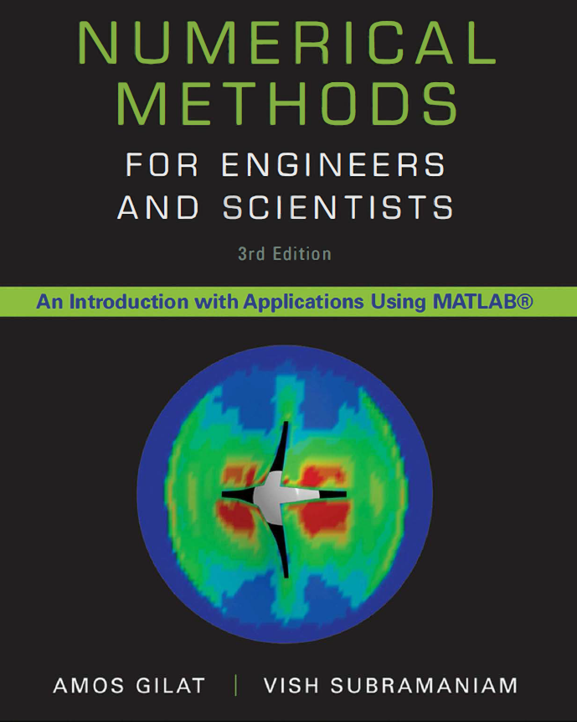
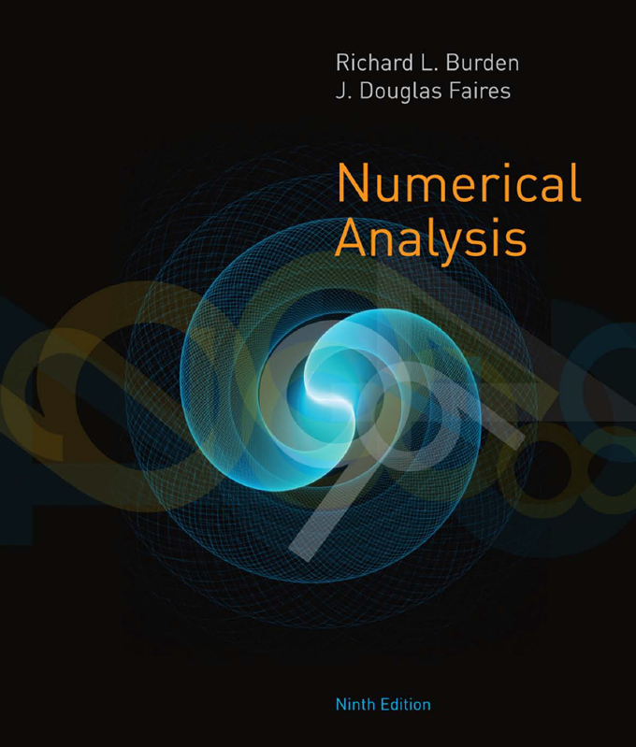
Bibliografía:

Slide 5
Clase 1
Introducción a los Métodos Numéricos
Dr. Luis Sanchez

Slide 6
Introduction to Numerical Methods
What are NUMERICAL METHODS?
Why do we need them?
Topics covered in this course.

Slide 7
Numerical Methods
Numerical Methods:
Algorithms that are used to obtain numerical solutions of a mathematical problem.
Why do we need them?
1. No analytical solution exists,
2. An analytical solution is difficult to obtain or not practical.

Slide 8
Outlines of the Course
Error, Taylor Theorem
Solution of nonlinear Equations
Solution of a System of nonlinear Equations
Solution of linear Equations.
Least Squares curve fitting
Interpolation
Numerical Integration
Numerical Differentiation
Solution of ordinary differential equations
Solution of Partial differential equations

Slide 9
Solution of Nonlinear Equations
Some simple equations can be solved analytically:
Many other equations have no analytical solution:

Slide 10
Methods for Solving Nonlinear Equations
Bisection Method
Newton-Raphson Method
Secant Method

Slide 11
Systems of Nonlinear Equations
Systems of Nonlinear Equations
Locate the roots of a set of simultaneous nonlinear equations:

Slide 12
Solution of Systems of Linear Equations

Slide 13
Cramer’s Rule is Not Practical

Slide 14
Methods for Solving Systems of Linear Equations
Naive Gaussian Elimination
Gaussian Elimination with Scaled Partial Pivoting
Algorithm for Tri-diagonal Equations

Slide 15
Curve Fitting: 1. Least Squares curve fitting
Given a set of data:
Select a curve that best fits the data. One choice is to find the curve so that the sum of the square of the error is minimized.

Slide 16
2. Interpolation
Given a set of data:
Find a polynomial P(x) whose graph passes through all tabulated points.

Slide 17
Methods for Curve Fitting and Interpolation
Least Squares
Linear Regression
Nonlinear Least Squares Problems
Interpolation
Newton Polynomial Interpolation
Lagrange Interpolation

Slide 18
Integration
Some functions can be integrated analytically:

Slide 19
Methods for Numerical Integration
Trapezoid Method.
Simpson Method.
Romberg Method.
Gauss Quadrature

Slide 20
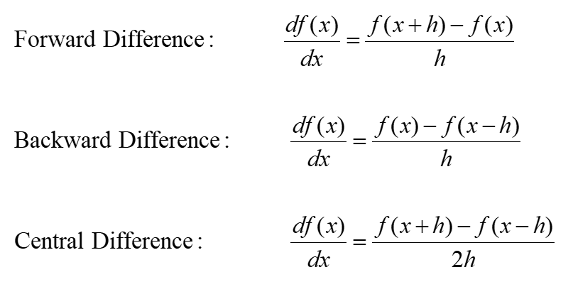
Numerical Differentiation

Slide 21
Solution of Ordinary Differential Equations (EDO)

Slide 22
Solution of Partial Differential Equations
Partial Differential Equations are more difficult to solve than ordinary differential equations:

Slide 23
Summary
Numerical Methods:
Algorithms that are used to obtain numerical solution of a mathematical problem.
We need them when
No analytical solution exists or it is difficult to obtain it.
Topics Covered in the Course
Solution of Nonlinear Equations
Solution of Linear Equations
Curve Fitting
Least Squares
Interpolation
Numerical Integration
Numerical Differentiation
Solution of Ordinary Differential Equations

